Slide 1
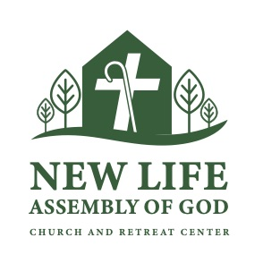
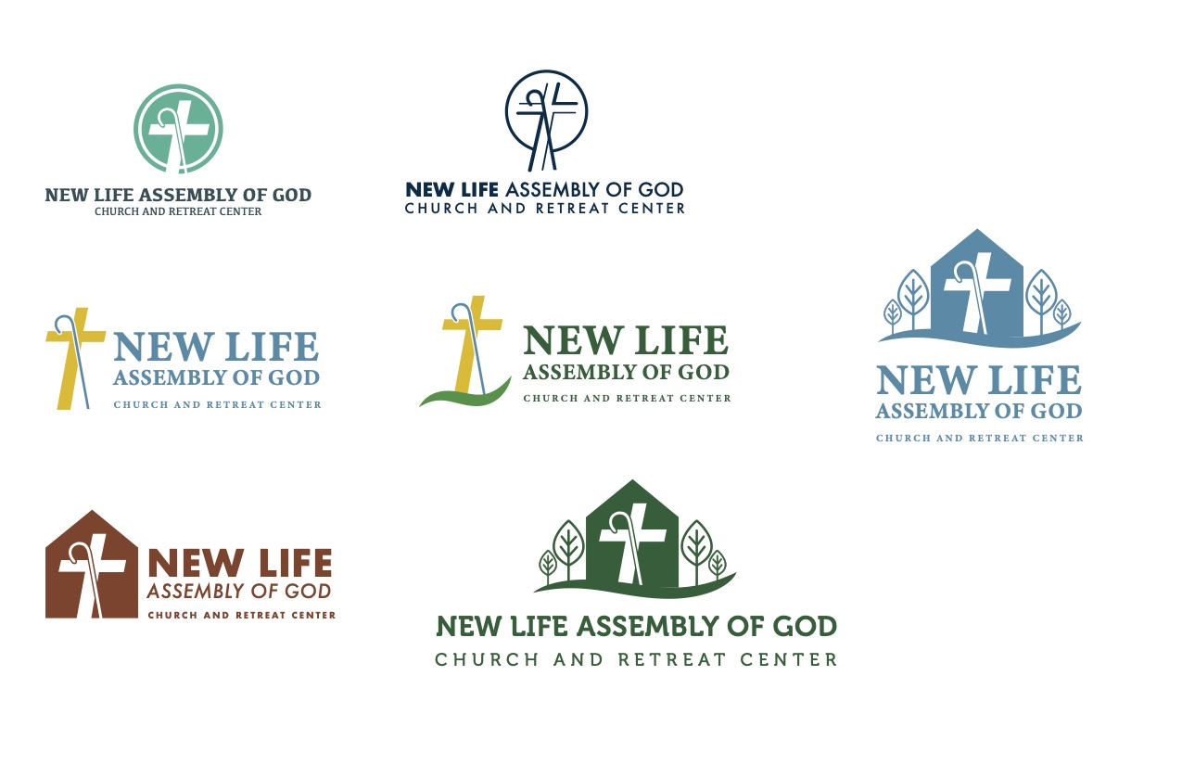
Recommended logo with stacked type option:
Cross & Staff center focus
Greenery/trees represents new growth and uniqueness of property for both retreat center and church
Swoosh:
  Grounds logo with contemporary, uplifting feel
  Represents cradling/safety in palm of God’s hands
  Symbolic of caring/nurturing church members

Slide 2
